Slide 1

Buffer
Build your audience and grow your brand on social media.

Slide 2

“It won't be long before Social Media Marketing will surpass SEO.”
DONANZA

Slide 3
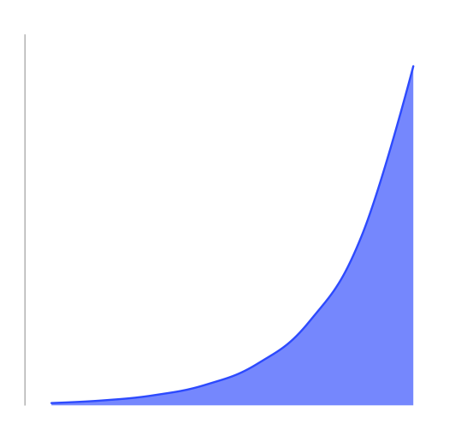
Mark Zuckerberg's Law of Engagement
“The amount of information a user shares today is twice the amount they shared a year ago.”

Slide 4
How do you use Social to drive traffic?

Slide 5
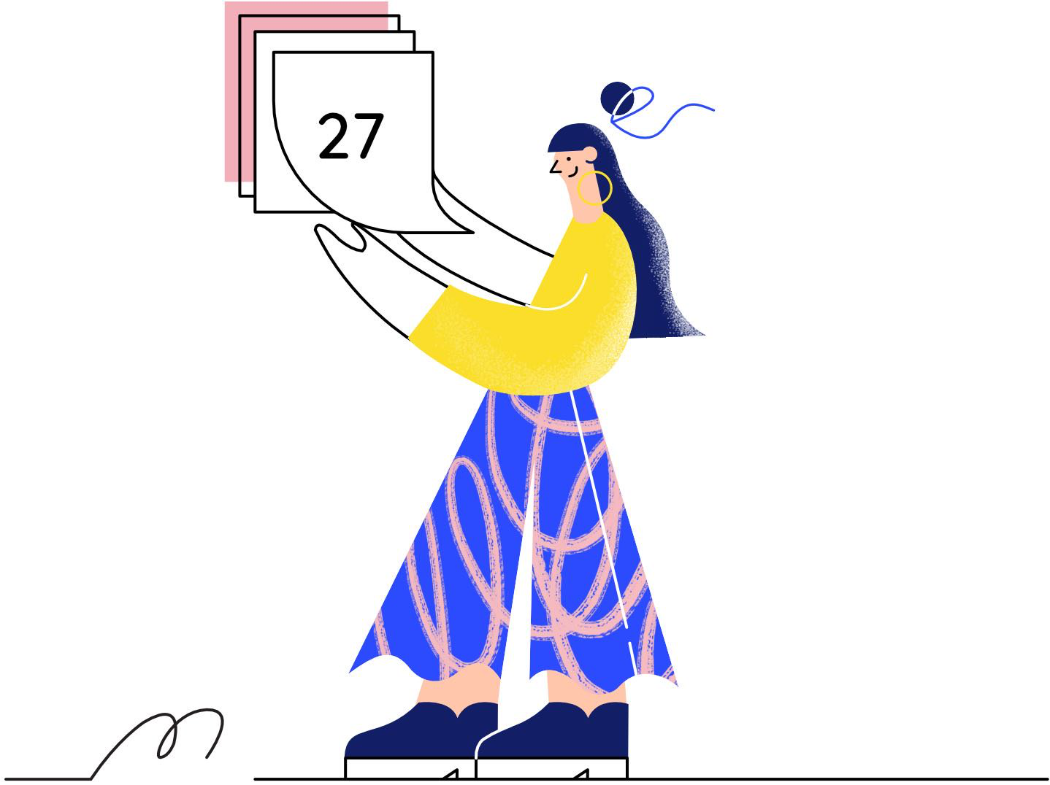
Queue your updates.

Slide 6

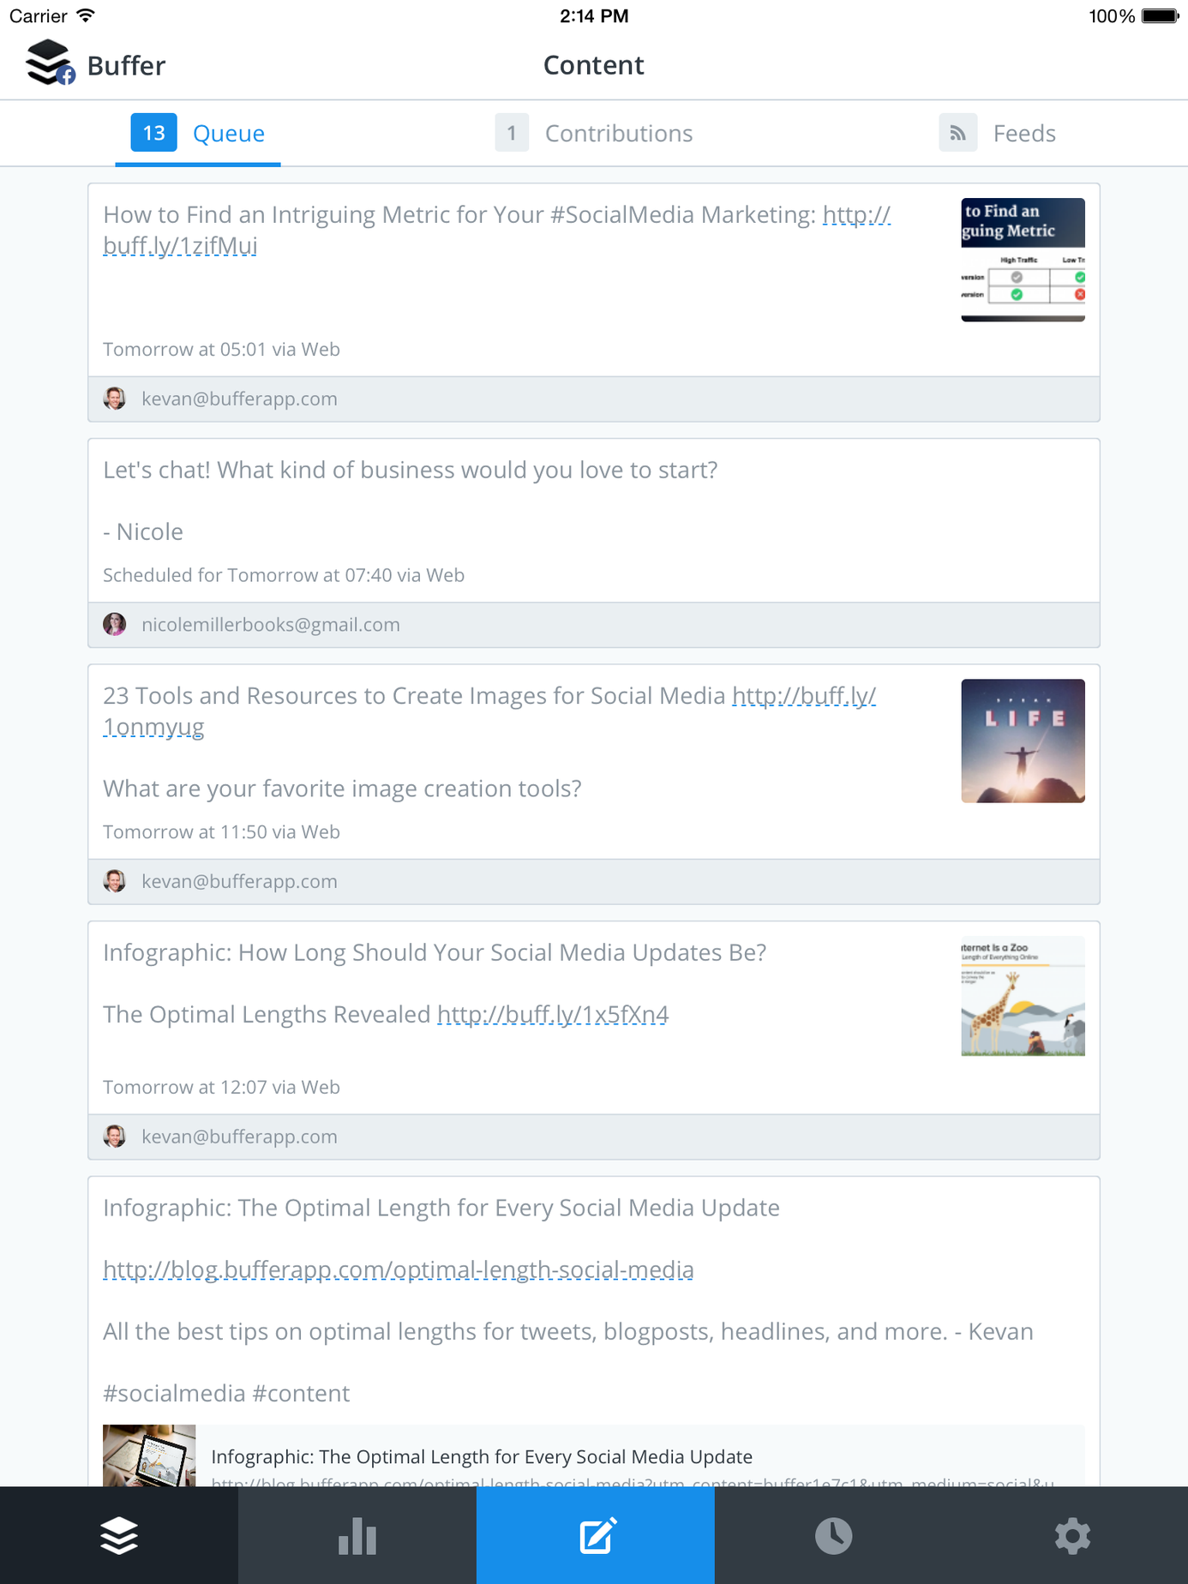
Scheduling
Create a preset publishing schedule for each social account
Tailored Posts
Custom tailor your posts for each social network
Calendar
Get an at-a-glance view of all the content you have lined up

Slide 7
Traction
800 paying users
$150,000 annual revenue rate
97% margins
55,000 users, growing 40% per month
1.5 million updates buffered

Slide 8
Milestones
100,000 users ($288k revenue)
Launched web app
January 2011
January 2012
Launch the API
October 2011
Integrated in 50 apps
December 2011
55,000 users
1M users ($3.6M revenue)
October 2011
January 2013

Slide 9
Business Model
Freemium model with consistent 2% conversion from Free to Paid plans
5% churn equates to a LTV of $240 and allows us to pay up to $5 to acquire a free user
At 1 million users, our projected revenue is $3.6M

Slide 10
Social Media Landscape
Of 200M daily Tweets, 55% contain links
4 billion items shared on Facebook per day
Zuckerberg's Law shows exponential growth of sharing
Traffic through social is soon to surpass traffic from search

Slide 11
“Buffer finds Tweet scheduling can increase clicks by 200%”
READ WRITE WEB

Slide 12



A Sharing Standard
6 integrations so far
In talks with Reeder, Pocket and Feedly
We plan to become the default sharing standard in any app

Slide 13









Competitive Landscape
Seesmic
Social Media Dashboards
Intelligent Sharing
Type text
Social Flow
Type text
HootSuite
Timely
Type text
Type text
Buffer
Tweet
Type text
Type text
Facebook
Twitter
Google+
Type text
Type text
Buffer
Twuffer
LinkedIn
Type text
Type text
Type text
Yoono
twAitter
Add This
Type text
Type text
Type text
Scheduling Apps
Sharing Platforms

Slide 14

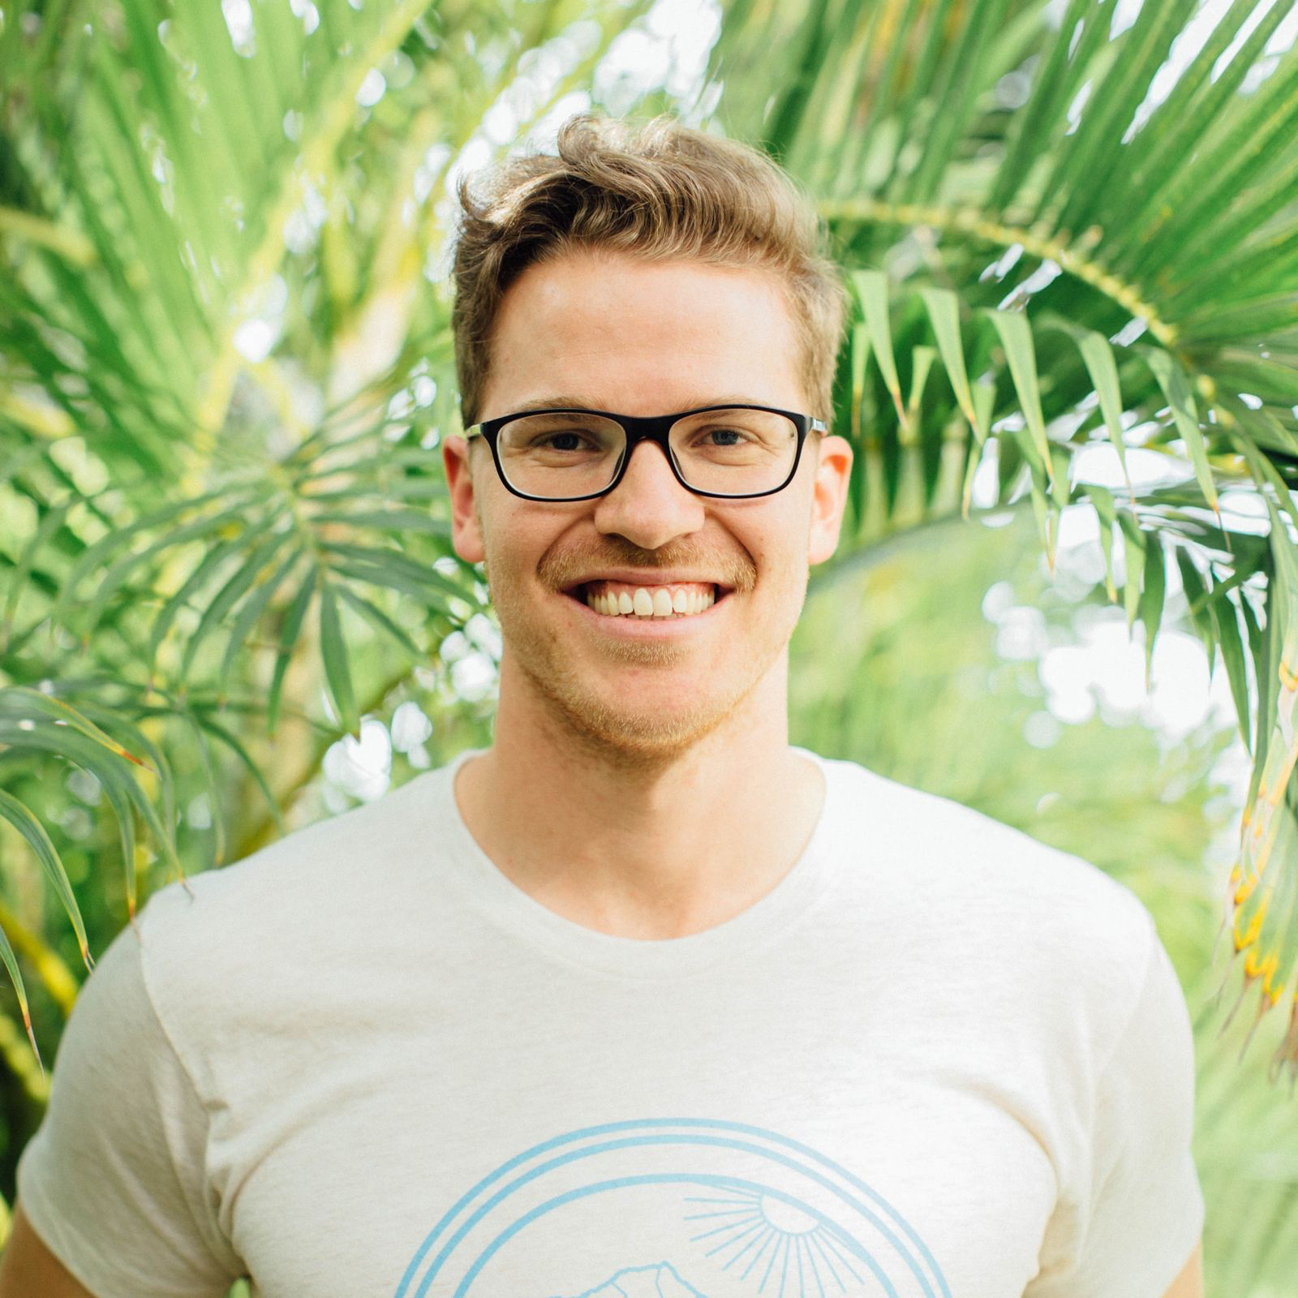
Founding Team
Joel Gascoigne
Leo Widrich
Took idea to revenue in 7 weeks,
Masters in CS
Marketeer, took Buffer
from 200 to 55,000 users

Slide 15
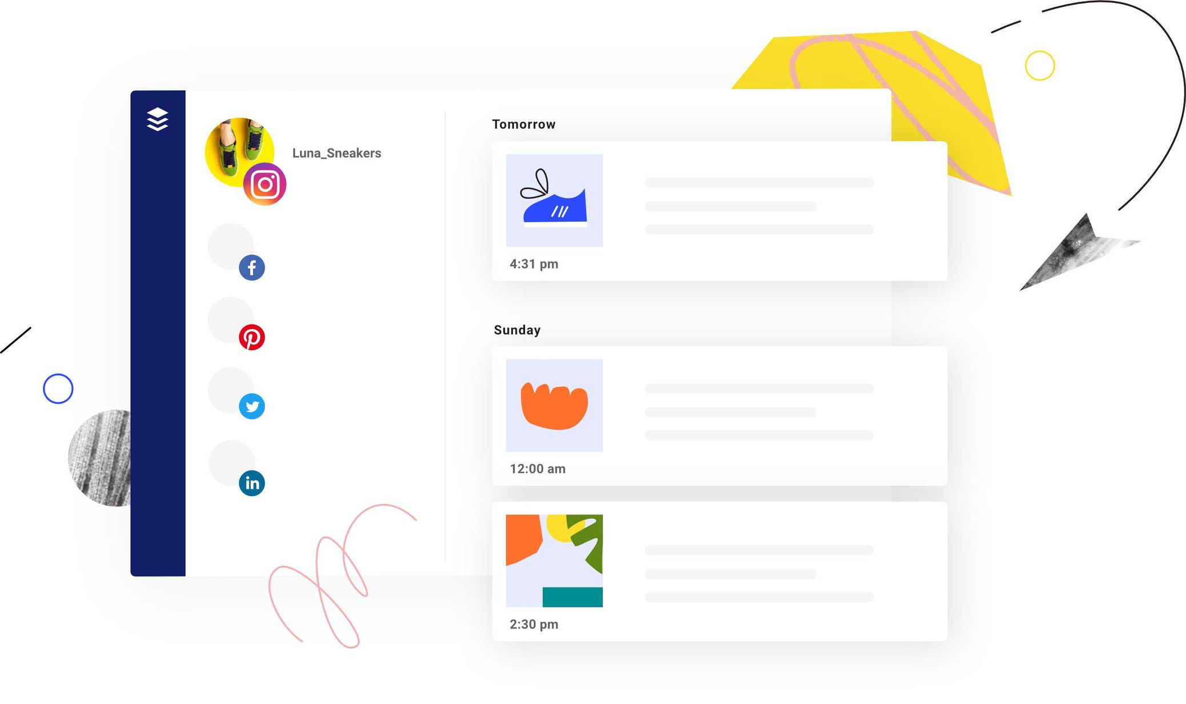
Reach out
Founders@bufferapp.com
410-123-4566
www.buffer.com
@buffer

Slide 16

Empower your team to build consistently beautiful presentations like this one.
Head to Beautiful.ai and get started.

